Slide 1

HTML Tables
Pavel Sucharev
2022

Slide 2
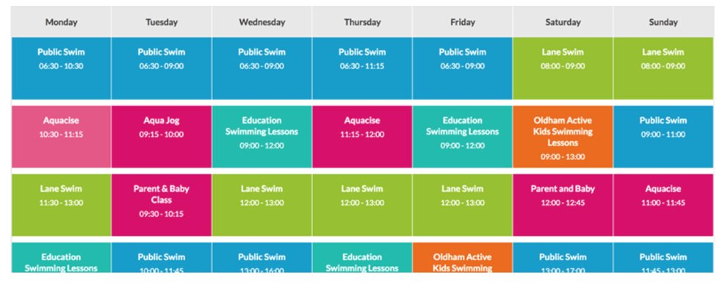
HTML Tables
HTML Tables
A table is a structured set of data made up of rows and columns (tabular data).

Slide 3
HTML Tables: <tag>
HTML Tables
<table></table> – initial wrapper for all table.
<tr></tr> – table row, describes how many rows will be in a table (a child of <table>).
<td></td> – table data, describes columns (a child of <tr>).
<th></th> – table header, describes element. Special cell that goes at the start of a row or column and defines the type of data that row or column contains.

Slide 4
<Užduotis>
HTML Tables
Build a simple table with:
Tags <table>, <tr>, <td>;
Include 3 rows;
Include for columns;
Content of cells, "hello world!"

Slide 5
HTML Tables: spanning multiple rows/columns
HTML Tables
<table>
<tr>
<th colspan="2">Some text</th>
</tr>
</table>
<table>
<tr>
<th rowspan="2">Some text</th>
</tr>
</table>

Slide 6
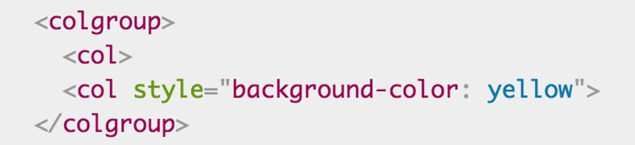
HTML Tables: providing common styling
HTML Tables
<colgroup> – this tag is responsible for styling all columns at once. The children of <colgroup> is <col>.

Slide 7

<Questions?>

Slide 8
<Užduotis>
HTML Tables

Slide 9
Naudinga informacija
CSS
w3schools
https://www.w3schools.com/html/html_tables.asp
table colspan
https://www.w3schools.com/tags/att_td_colspan.asp
table rowspan
https://www.w3schools.com/tags/att_td_rowspan.asp

